Slide 1


intro 1
INSIGHTS FOR CODEX MARKETING TEAM
Data Analysis of Consumer survey Response about Energy Drinks.
By Vignesh
A codebasics Resume Project Challenge

Slide 2
intro 1
About CodeX :
CodeX is a Germen Beverage Company which Launched its Energy Drink recently in India. By launching in 10 Indian Cities few months back they reached a considerable number of consumers. Their Marketing Team responsible for reach more potential customers used different methods of Marketing and conducted some Marketing campaigns. And They also conducted consumer survey among 10 thousand peoples from 10 different cities. Now Its time for uncover the impact from their campaigns.
Role :
I am taking the Role of Peter Pandey, Renowned Data Analyst. Who assigned to peel off the layers of survey Data and derive crucial Information from the responses of the consumers. Figure out the current situation of CodeX and give some actionable Recommendations to Improve their product and The Brand statues.
Notes:
actionButton
No alt text provided

Slide 3
intro 1
Contents
1.
3.
Consumers Preference
4.
Marketing Channels and Brand Awareness
5.
Demographic Insights
Brand Penetration
6.
Purchase Behavior
7.
Product Development
8.
Recommendations
2
Competition Analysis
Notes:
actionButton
No alt text provided

Slide 4
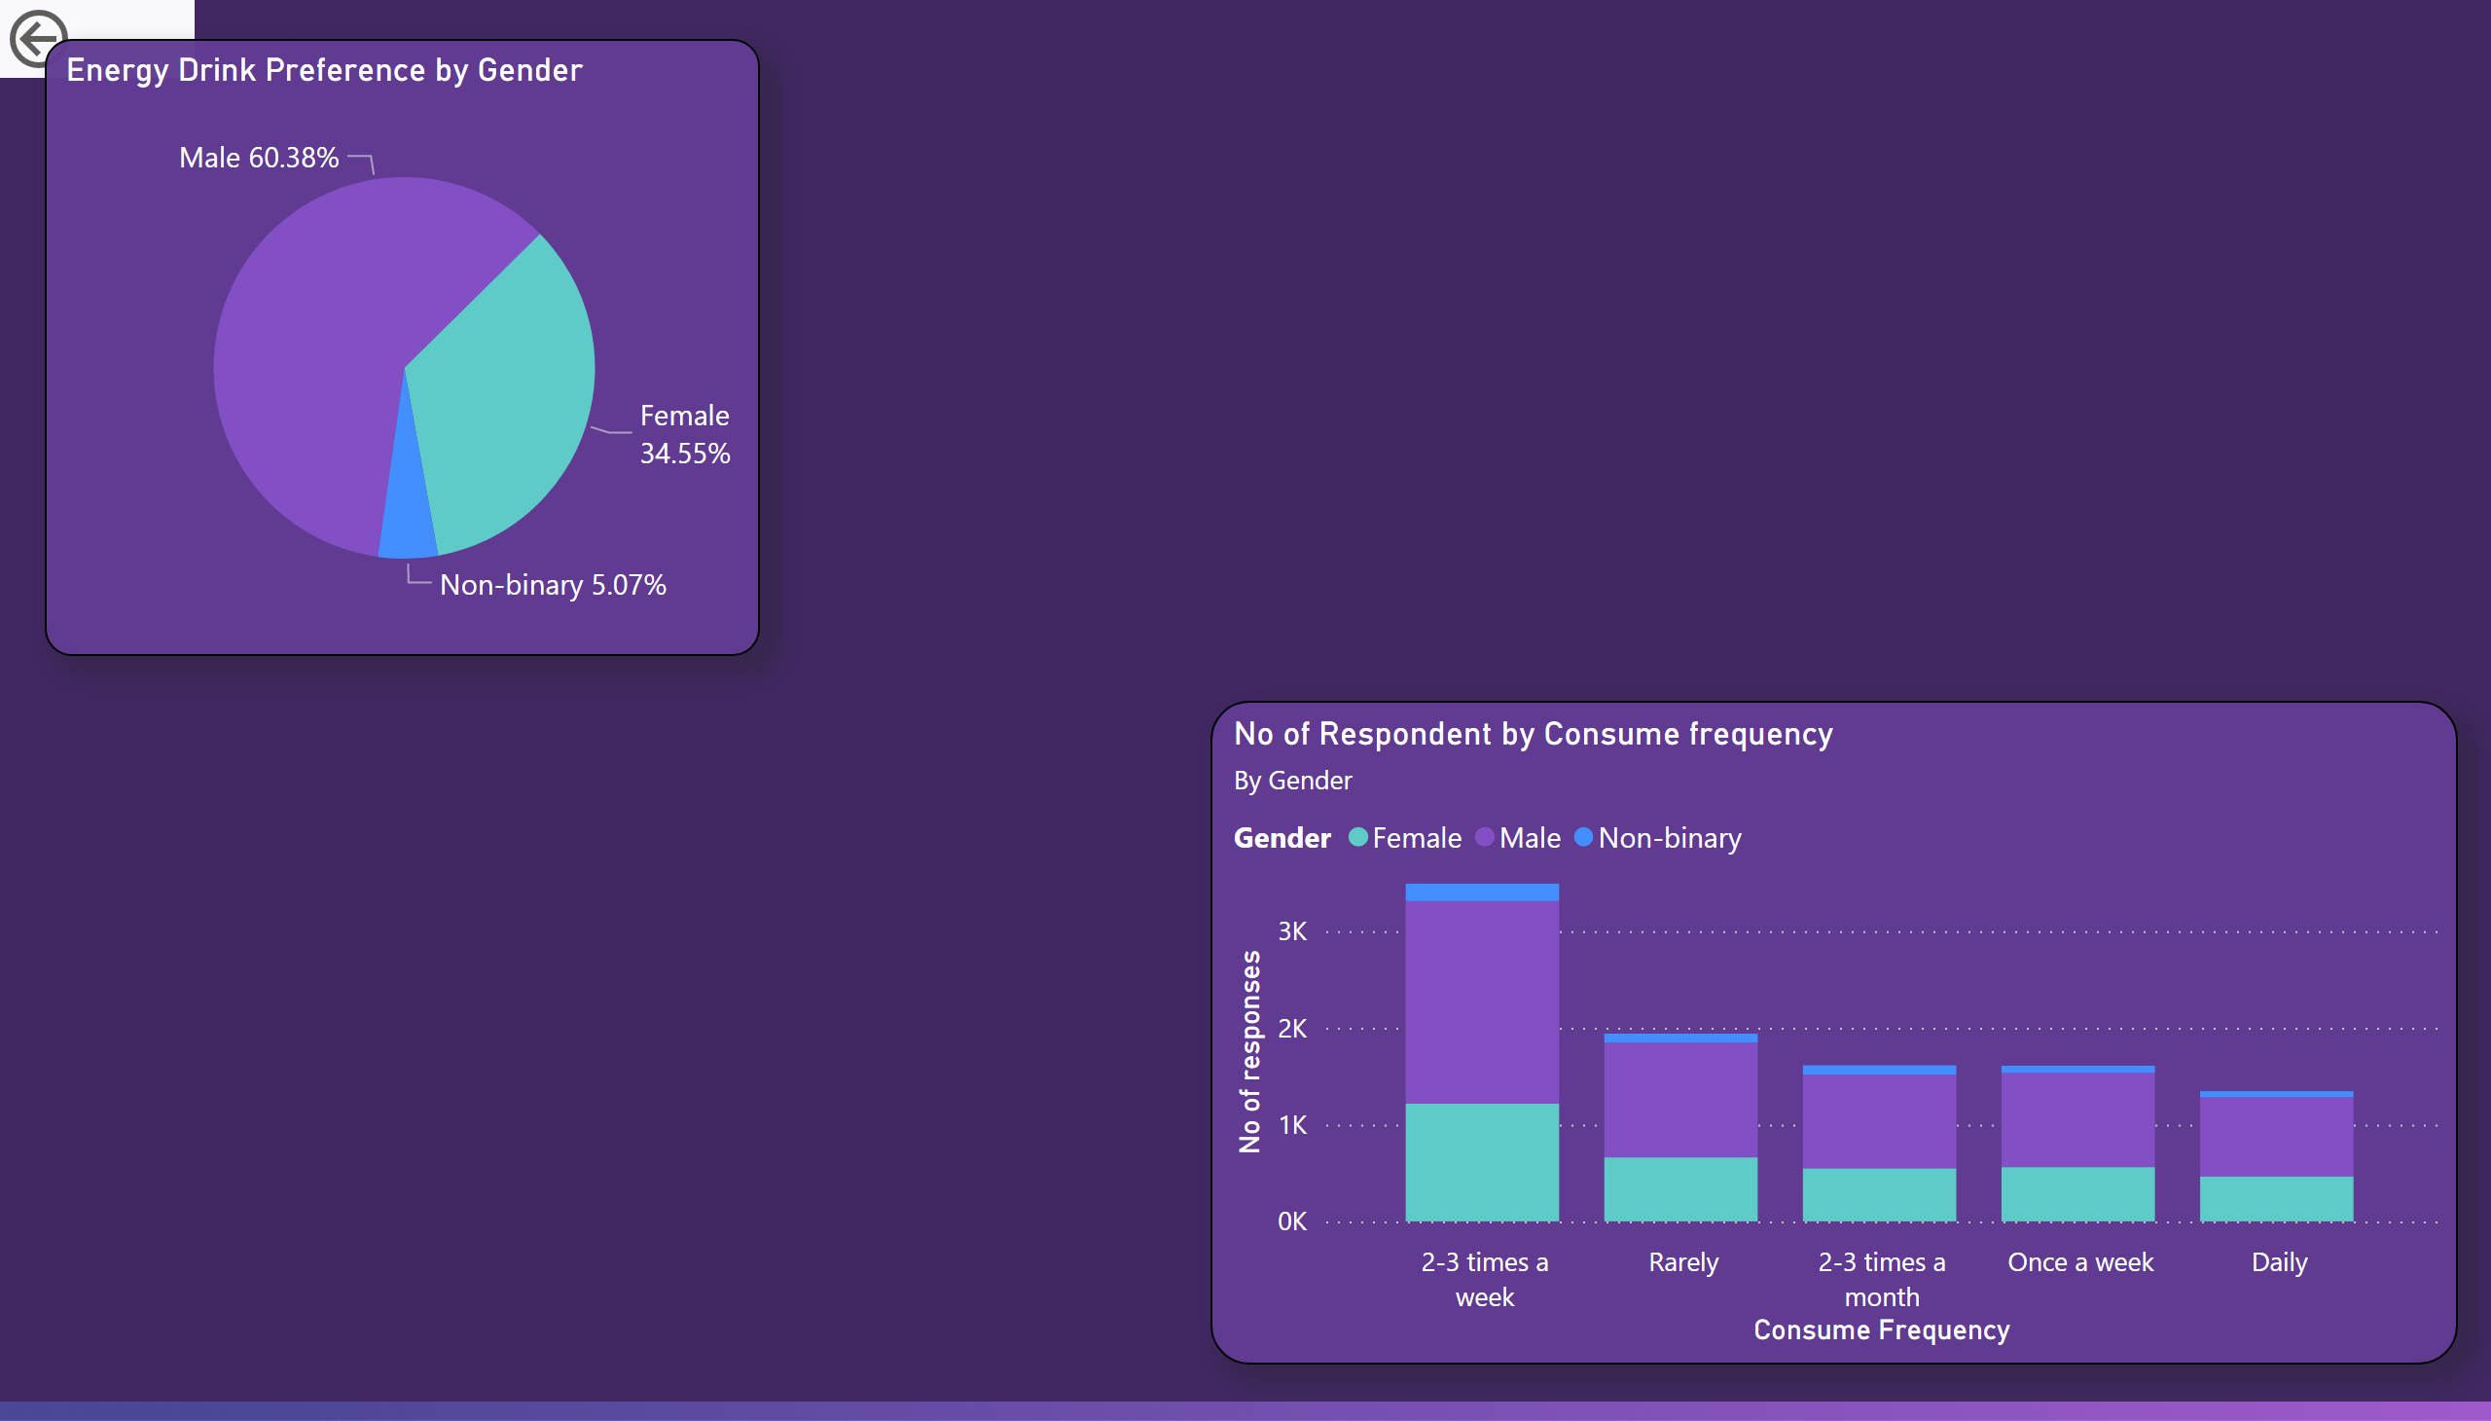
ppt 1
1.Demographic Insights:
The total response from survey is 10K out of which 60.3% are male, 34.6% are female and Rest are Non-binary.
Who prefers Energy Drink more?
From chart from right side its clear that Male Prefer Energy Drinks more and followed by Women.
And most of the respondents prefer to drink 2-3 times a week.
Notes:
Energy Drink Preference by Gender
No alt text provided
actionButton
No alt text provided
No of Respondent by Consume frequency
No alt text provided

Slide 5
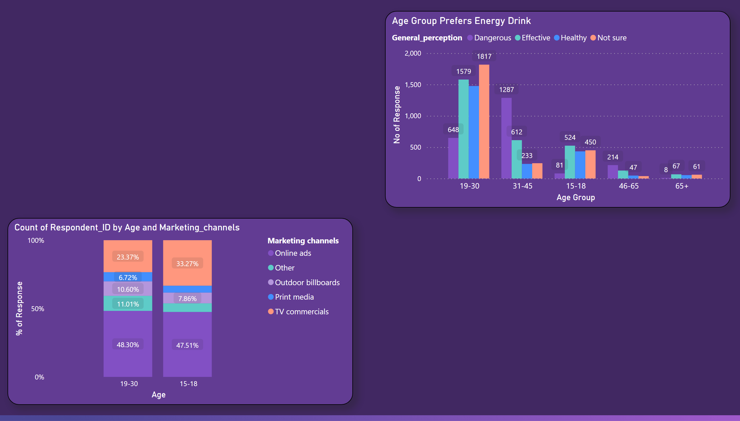
ppt 1 1
Which Age group prefers energy drink more?
In the Age group of 19-30 prefers more Energy drink than others. Even though some of them think it is not healthy.
And followed by 15-18 prefers and think it is Healthy and Effective for their Health.
People who think dangerous also responded that they drink Energy drink sometimes or rarely.
Which type of Marketing reaches more Youths?
Online ads plays main role in reaching most of the youth. In both age group nearly 50% of respondents seen Energy drink ads online.
TV commercials also have potential to reach more youths on average than all other Marketing channels combined.
Notes:
hundredPercentStackedColumnChart
No alt text provided
Age Group Prefers Energy Drink
No alt text provided

Slide 6
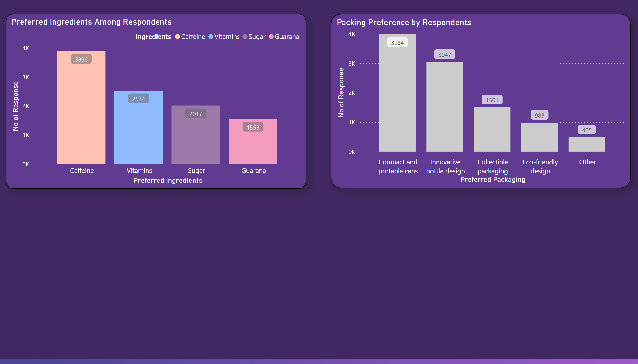
ppt 2
2.Consumer Preferences:
What packaging preferences do respondents have for energy drinks?
Most consumers prefer compact and portable cans obviously for their convenient while travelling and possibly easier for Workout.
Second most says Innovative Bottle designs and considerable number says they want Eco-Friendly packaging.
What are the preferred ingredients of energy drinks among respondents?
More number of consumers prefer caffeine. This takes nearly one third of all the preference.
Followed by vitamins and sugar in second and third preferences.
Notes:
Packing Preference by Respondents
No alt text provided
Preferred Ingredients Among Respondents
No alt text provided

Slide 7
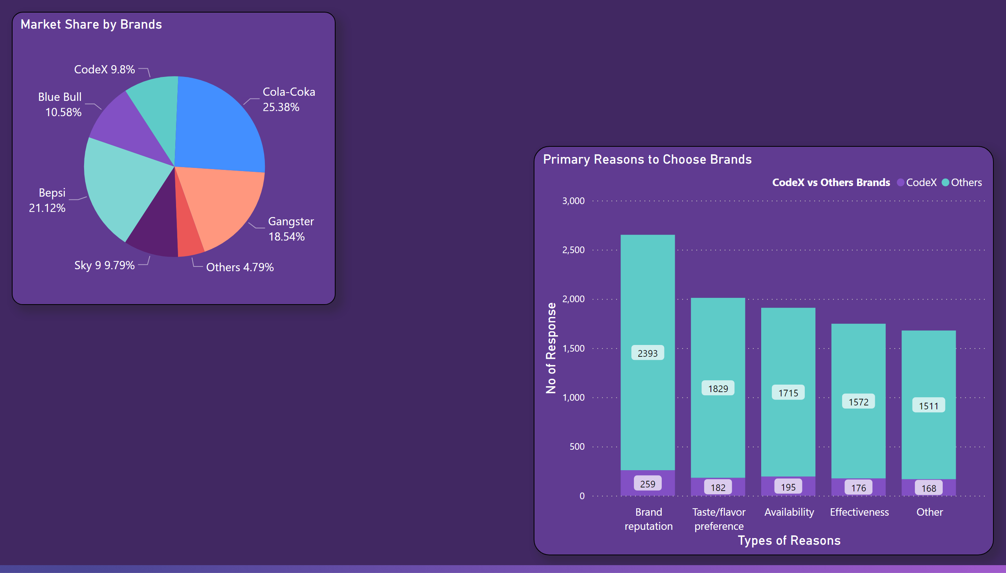
ppt 3
3.Competition Analysis:
Currently with 25% of market share Cola-Coke stays at top.
CodeX is in tug with Sky 9 stay on 5th place.
Market Share:
Cola-Coka
Bepsi
Gangster
Blue Bull
CodeX
Sky 9
Reasons For Choosing Current Brand:
Most respondents comes up and saying Brand Reputation, that goes for CodeX too.
Second of All, Taste/Flavor plays considerable Role for choosing the brand and staying with it.
And another notable thing is Availability.
Notes:
Primary Reasons to Choose Brands
No alt text provided
Market Share by Brands
No alt text provided

Slide 8
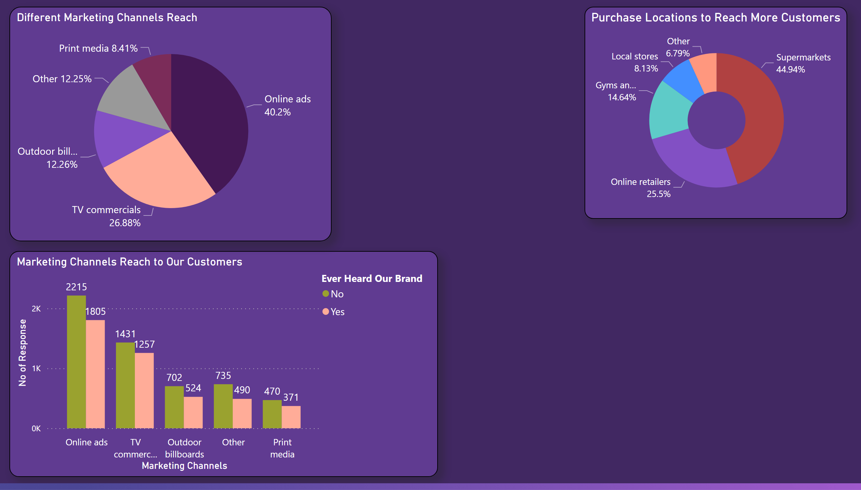
ppt 4
4.Brand Awareness:
Online Ads are more effective in reaching more customers followed by TV ads.
Online ads can be more Effective since it can be more specific towards target audience.
CodeX Customer Reach:
Customers who see ads about Energy drinks online nearly Half of all heard about CodeX or been aware of CodeX.
TV ads and Billboards follows second and third.
To Reach more potential Customers CodeX needs to consistent in the Online ad platforms.
Apart from that, Reaching local supermarkets and getting shelf spaces can be effective since most people buy Drinks in Supermarket.
Notes:
Purchase Locations to Reach More Customers
No alt text provided
Different Marketing Channels Reach
No alt text provided
Marketing Channels Reach to Our Customers
No alt text provided

Slide 9
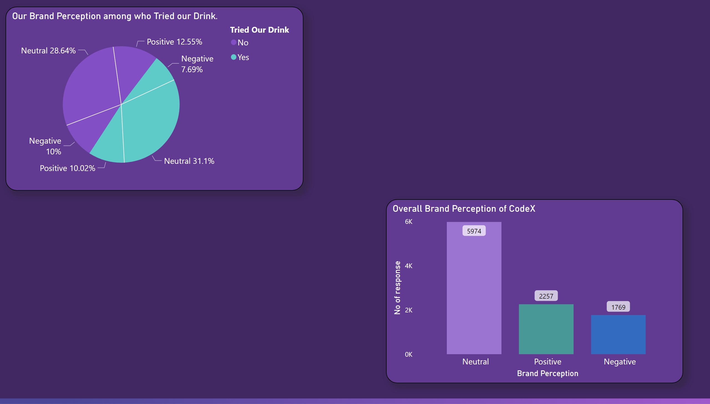
ppt 5
5.Brand Penetration:
What do people think about our Brand?
The Bar chart shows us most of the respondents have Neutral perception about CodeX.
About 60% of response points to Neutral perception. this can be good thing with some extra Attractive Campaigns and Product improvement we can change this perception to positive.
From the pie chart nearly 50% respondents Tried our brand before. And 20% people perceive CodeX Brand in Positive way. The trend of Neutrality continues here too.
Notable point is people who not tried our drink and thinking positive is better then who tried and thinking positive, also tried and thinking Negative is better than not tried and thinking negative.
Notes:
Our Brand Perception among who Tried our Drink.
No alt text provided
Overall Brand Perception of CodeX
No alt text provided

Slide 10
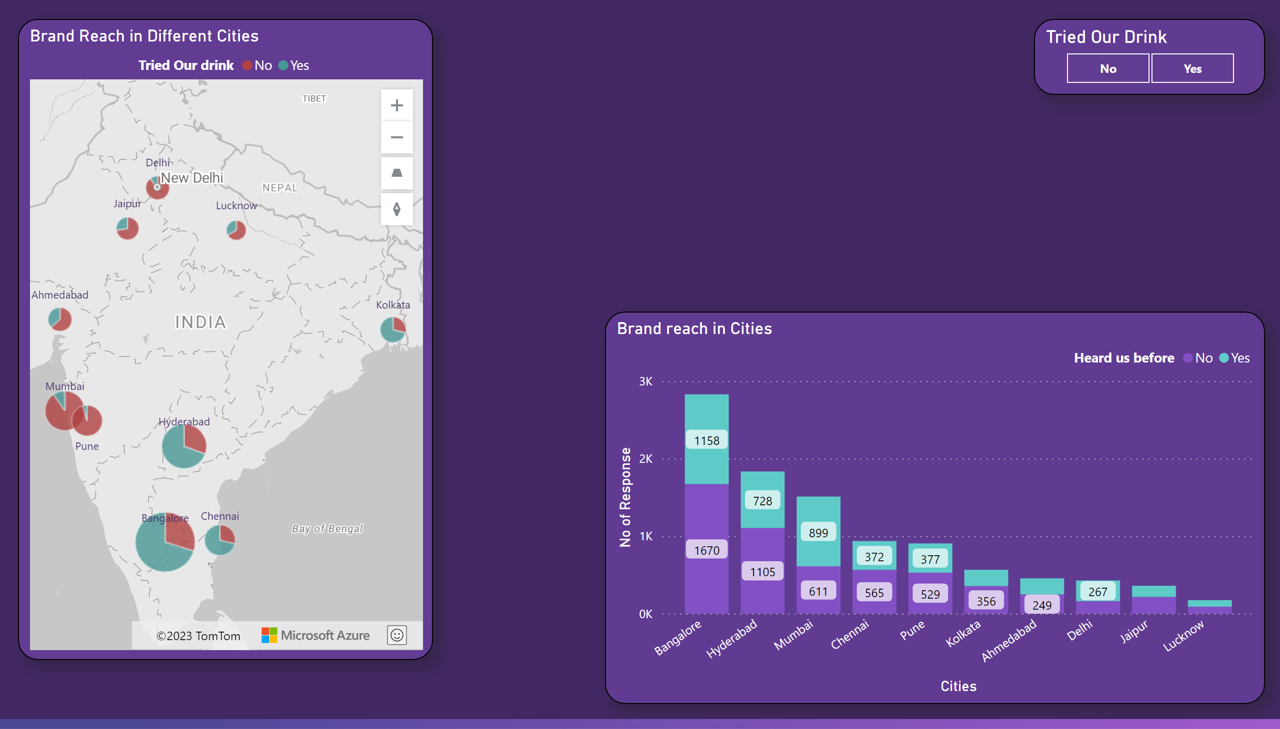
ppt 5 1
Brand Penetrated – cities.
Which cities do we need to focus more on?
The ratio of respondents Tried our Drink is more in Bangalore, Hyderabad, Chennai and Kolkata than the other Cities like Mumbai, Pune,…
Even though over half of respondents in Mumbai, Pune and other cities hear about our Drink(Bar chart) but not tried the Drink(Map). So, we need to focus more on these cities.
Cities Need to Focused:
Mumbai
Pune
Jaipur
Delhi
Jaipur
Note:- The number of response from Bangalore, Hyderabad is higher than the ones from Mumbai and Pune.
Notes:
Brand Reach in Different Cities
No alt text provided
Tried Our Drink
No alt text provided
Brand reach in Cities
No alt text provided

Slide 11
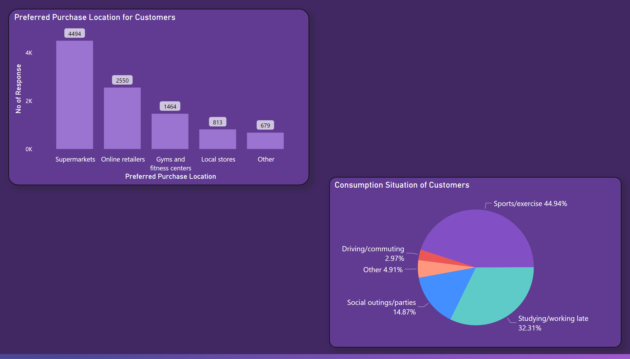
ppt 6
6.Purchase Behavior:
45% of the respondents prefer to Purchase their Energy drink in supermarkets.
Followed by Online retailers, Gyms/fitness centers itself, and local stores.
Pie chart reveals the possible consumption situation of Energy drink.
Not surprisingly, most of respondents consume while involved in Sports, exercise and fitness activity which is 45%.
32% responded - studying and working late. And followed by social outing/parties, other activities and Driving.
Notes:
Preferred Purchase Location for Customers
No alt text provided
Consumption Situation of Customers
No alt text provided

Slide 12
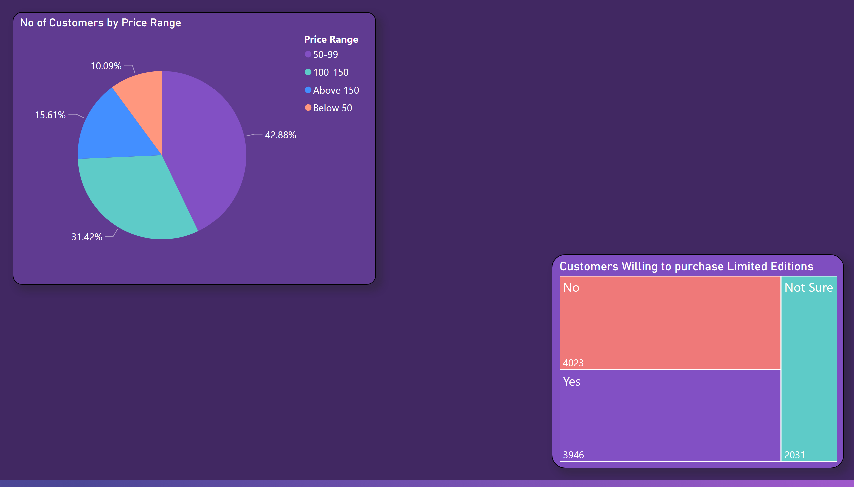
ppt 6 1
what factors influence respondents' purchase decisions, such as price range and limited-edition packaging?
Respondents mostly fall under the purchase price range of 50-99 Rupees.
And approx. 42-43% of consumers purchasing in 50-99 rupees. And choosing to do so while sticking to a preferred Brand regardless of Brand reputation, availability and other preferences.
Overall, most consumers whos’ willingness to purchase limited edition packs swings between Yes and No. And some ones are not sure regardless of the price they pay.
But consumers who have price range of 100-150 rupees are more willing to purchase the Limited-edition packs than the ones with 50-99 rupees.
Notes:
Customers Willing to purchase Limited Editions
No alt text provided
No of Customers by Price Range
No alt text provided

Slide 13
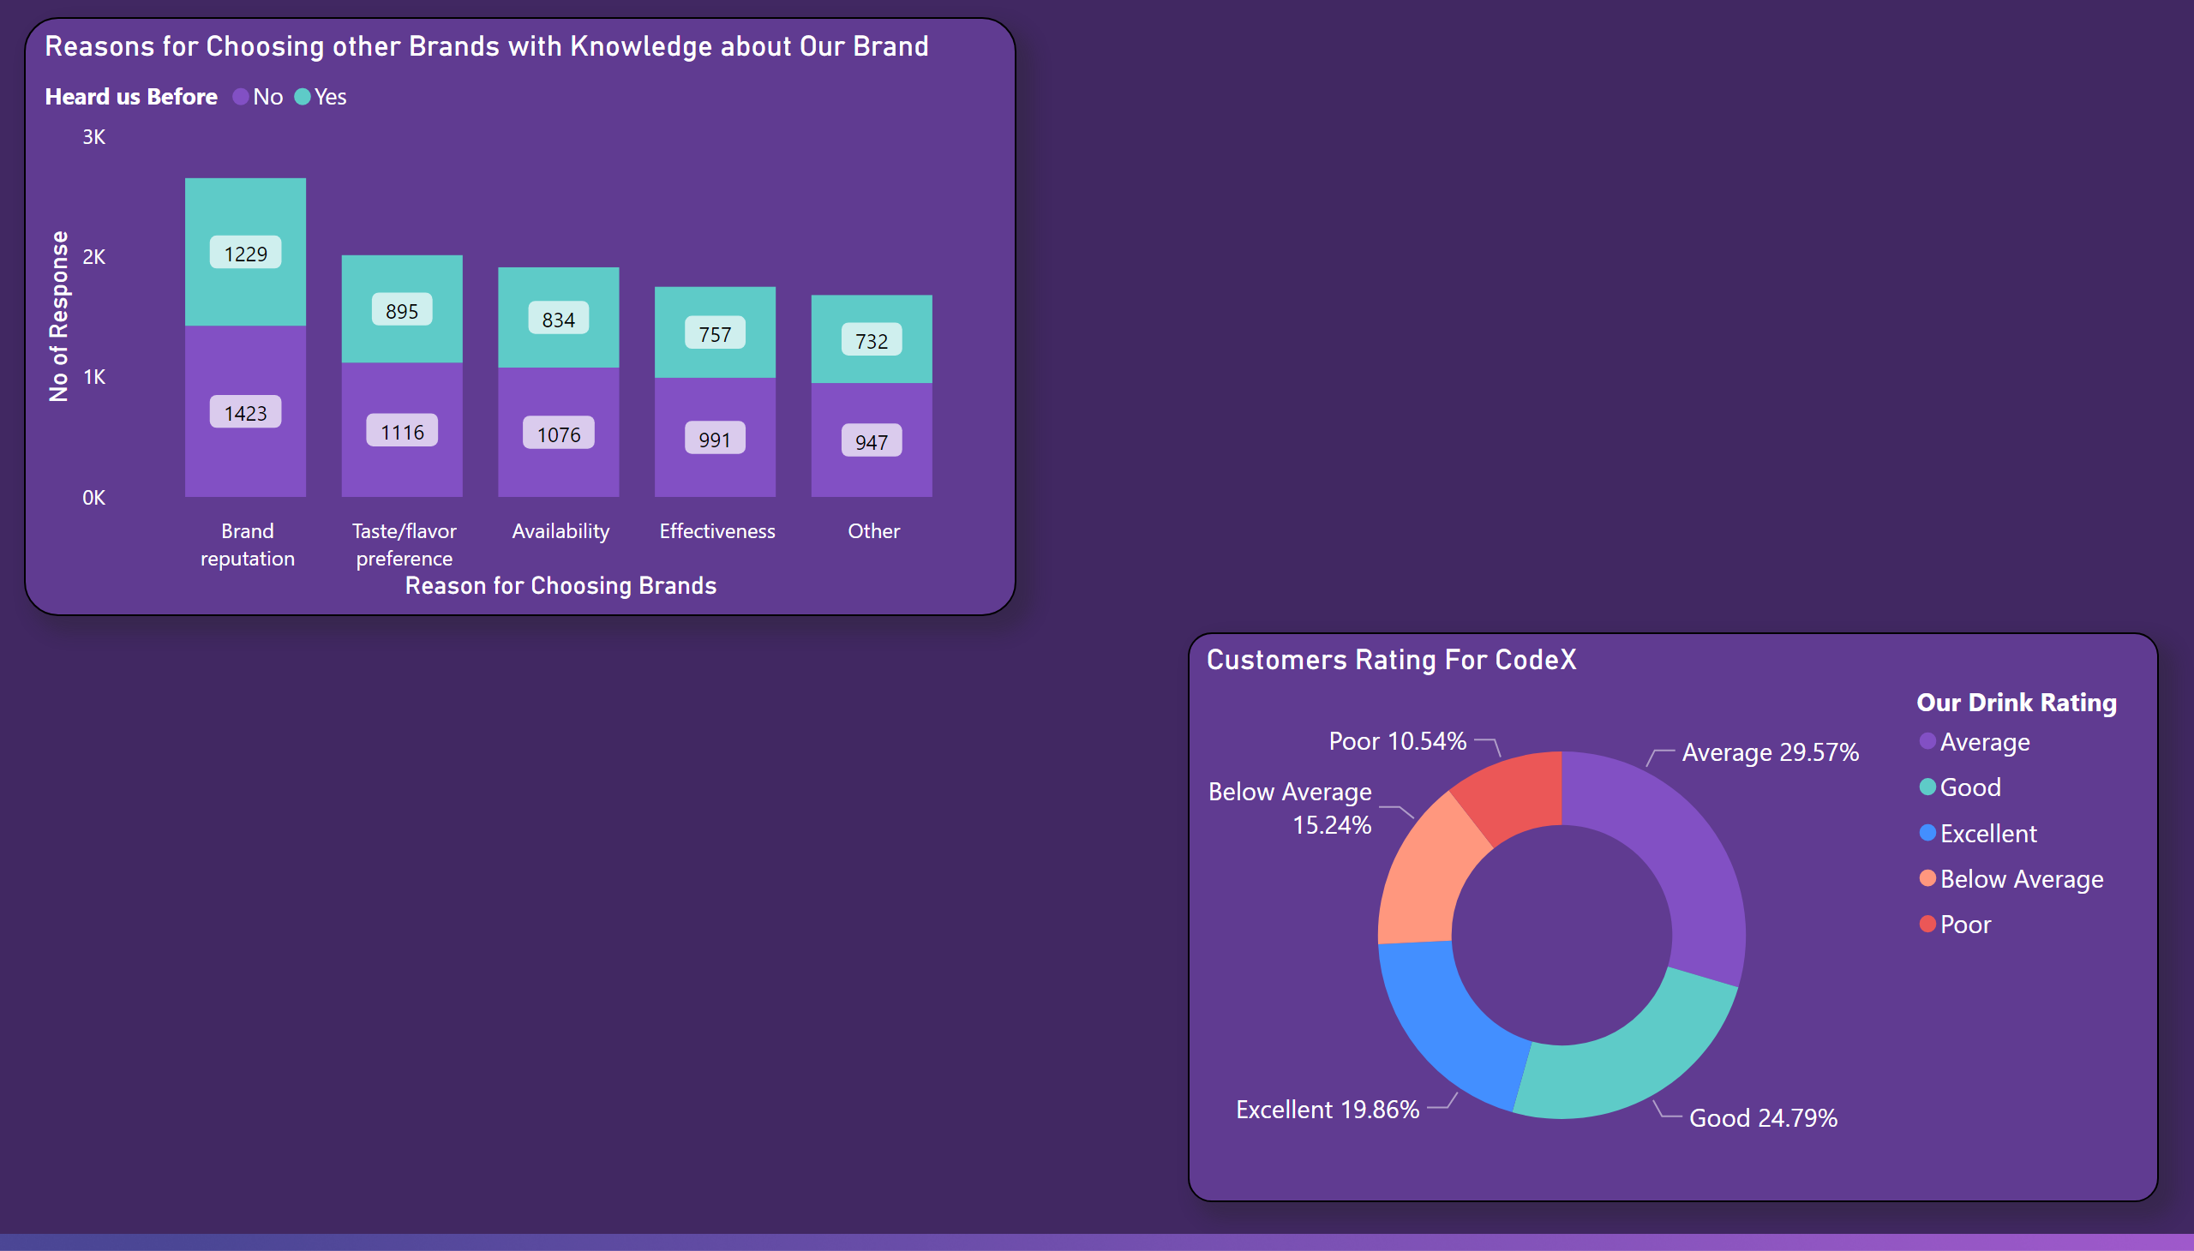
ppt 7
7.Product Development:
Which area of business should we focus more on our product development?
Bar chart from left shows that people choose their Brand for different reasons and In all the reasons more than Half of them not even Aware of CodeX presence in market.
So, CodeX need to focus more on Brand Awareness.
Donut Chart:
29.5% of respondents Rated Average for CodeX Energy drink Experience.
On the positive side 19.8% have Excellent Rating for Our Energy Drink.
Approx 5% consumers of all are tried our Energy drink and have poor experience of the taste.
6% not tried our drink and thinking taste experience would be Below Average.
On the upside 11% not tried and yet have Excellent experience rating.
Notes:
Reasons for Choosing other Brands with Knowledge about Our Brand
No alt text provided
Customers Rating For CodeX
No alt text provided

Slide 14
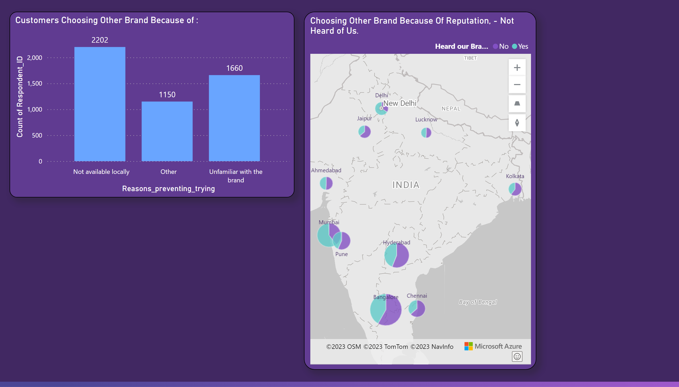
ppt 7 1
MAP:
Most Consumers who chose other brands just because of their brand reputation are not even Heard about our brand Presence.
This trend is higher in Bangalore, Chennai, Hyderabad, Kolkata and Jaipur. Hence, our marketing team have more way to go in terms of reaching higher brand awareness.
Local Availability:
Consumers who opted for other Brand Energy Drink (not codex) responded with the reason for choosing that brand was ‘Not Available locally’ , ‘Unfamiliarity’ of CodeX. This numbers are Considerably higher when compared to total 10k response.
This give us crucial information about demand-supply not met, and less brand awareness/Engagement. This problem needs serious consideration.
Note:- The number of response from Bangalore, Hyderabad is higher than the ones from Mumbai and Pune.
Notes:
Choosing Other Brand Because Of Reputation, - Not Heard of Us.
No alt text provided
Customers Choosing Other Brand Because of :
No alt text provided

Slide 15
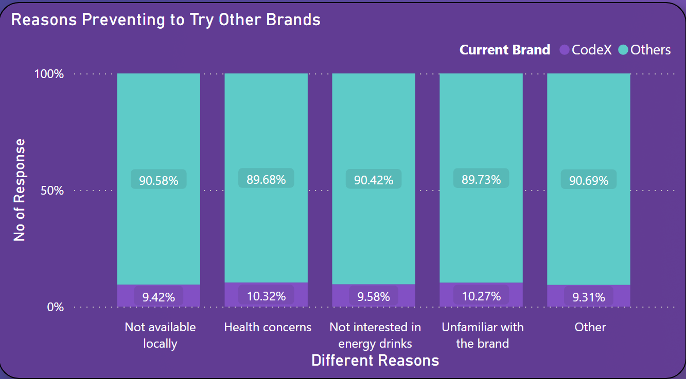
intro 1
8.Recommendations
What immediate improvements can we bring to the product?
Tackling Non-Availability:
Most people who chose other Brands responded that one of the main reason for is Not Availability. This numbers are considerable with the ones who tried our brand and switched to others.
This can be eliminated by Robust supply chain construction.
First, our drink should be available for them even to try, then only we can look onto other development statues.
Notes:
actionButton
No alt text provided

Slide 16
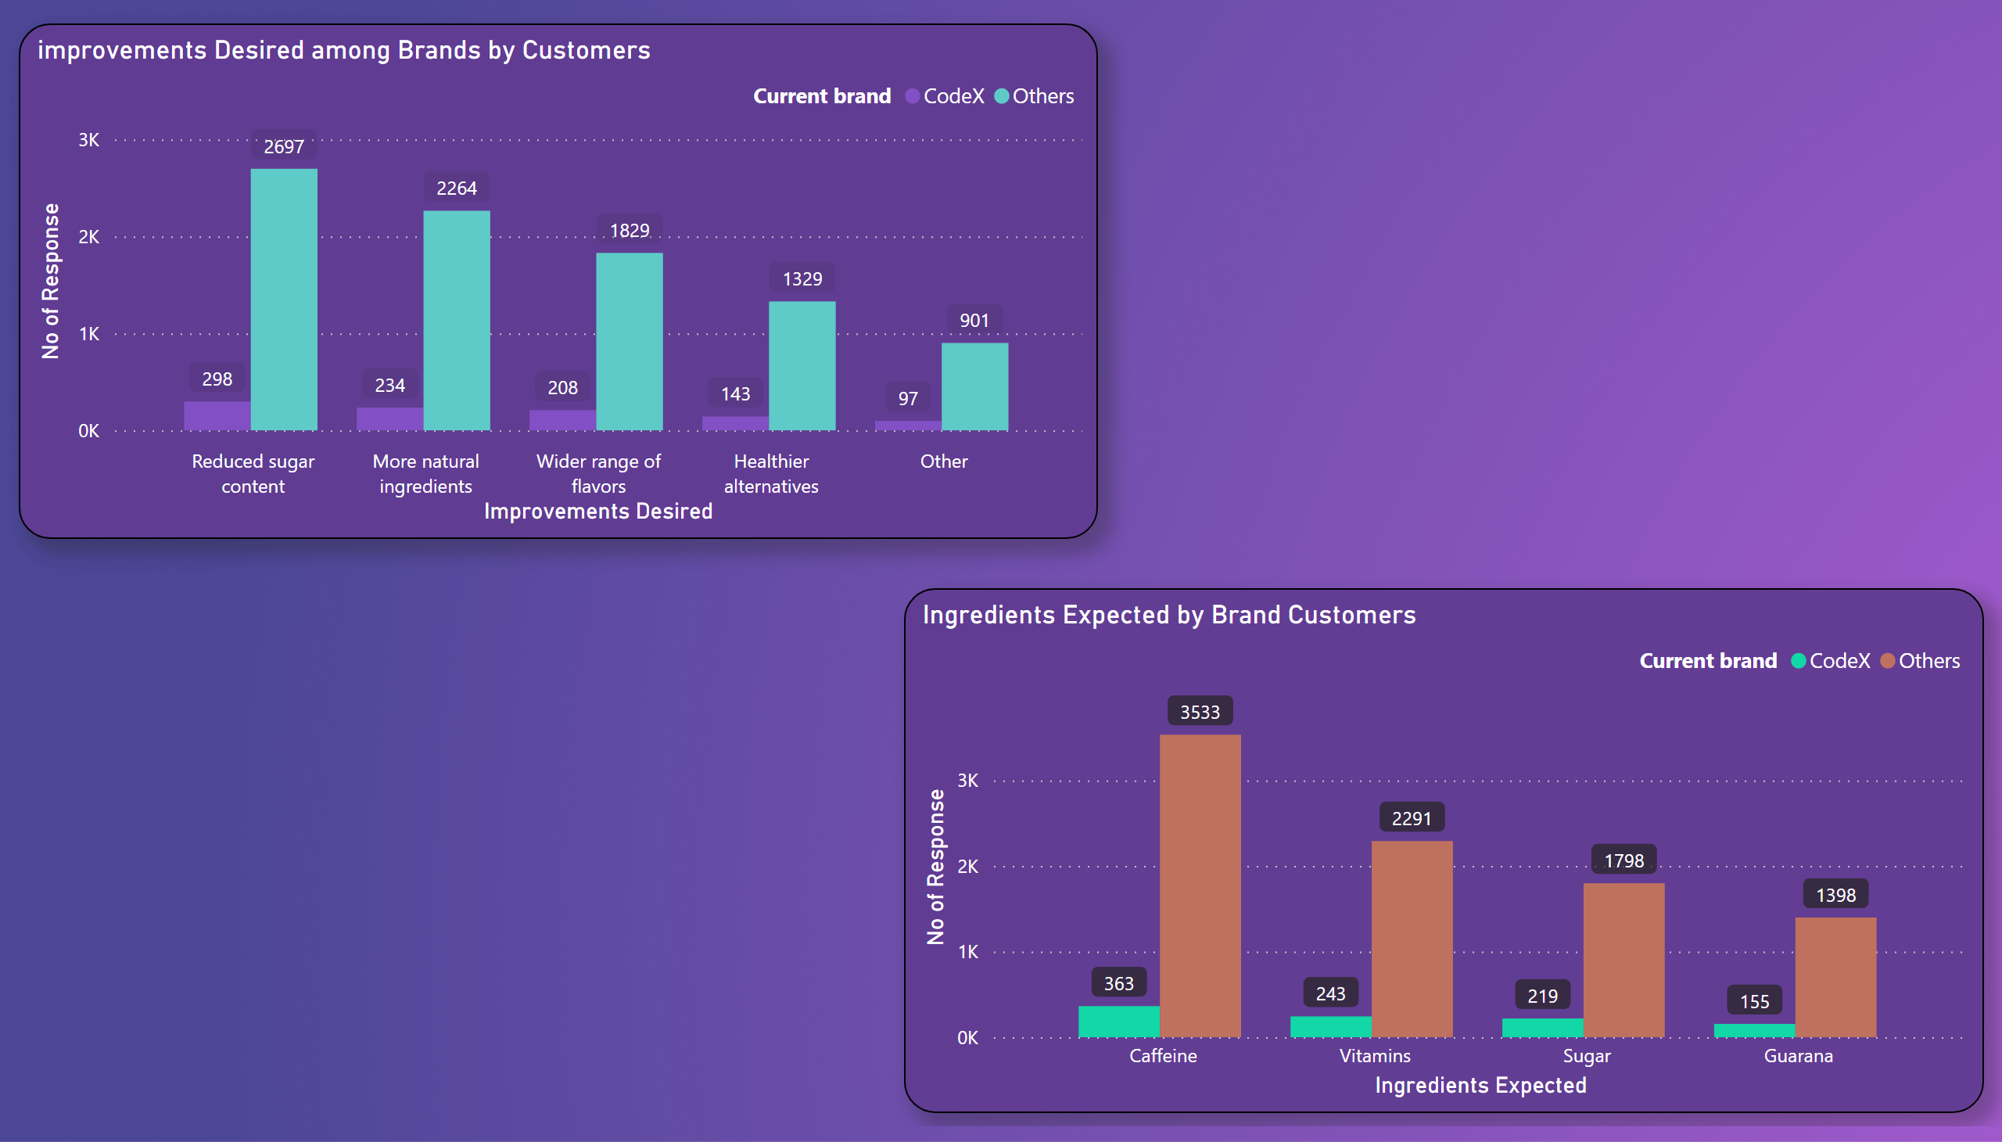
ppt 8
The expected Improvements from our consumer side is in compared with the CodeX and Other Brand users.
They are concerned with the more sugar content and Artificial or chemical ingredients in their drink.
CodeX should focus on these too.
Customers are more expected to have one or more of these Ingredients on their Drink.
Like caffeine, Vitamins, and others. CodeX can try to meet their consumers expectations.
Notes:
Ingredients Expected by Brand Customers
No alt text provided
improvements Desired among Brands by Customers
No alt text provided

Slide 17

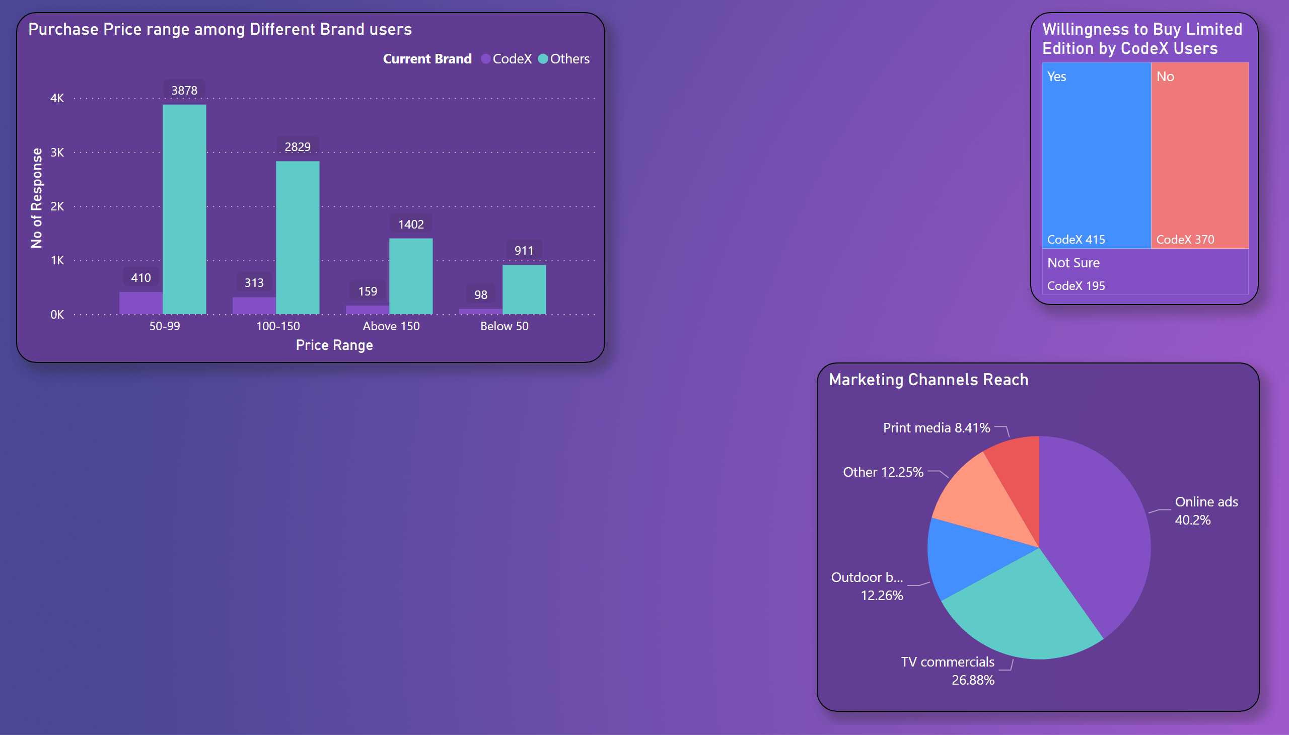
ppt 12
What should be the ideal price of our product?
The ideal price range of our drink should in 50-99 because most people buy in this range. And this price range is not too high or low and comprise more consumers.
And Most CodeX consumers are willing to buy our Limited-Edition Products. So, In premium side product line we might have a shot.
What kind of marketing campaigns, offers, and discounts we can run?
Influencer Partnerships: Collaborate with popular fitness or lifestyle influencers who align with your brand values.
Social Media Contests: Run contests on platforms like Instagram or Twitter where users can participate by sharing their moments, using a branded hashtag, or tagging CodeX brand.
Limited-Time Promotions: Offer time-limited discounts or "buy one, get one free" promotions to increase sales.
Student or Military Discounts: Offer special discounts for students or military personnel, as a recognition of their active lifestyle.
Notes:
Response by Age Group
No alt text provided

Slide 18
ppt 12
Who can be a brand ambassador, and why?
Choosing An Ambassador is crucial for Brand Image and reaching the target audience, they should be in align with our Energy drink values. So, we can choose someone who is from this category.
Fitness Influencers
Professional Athletes
Celebrities
I am not specific on one person but anyone who brings value. the Ambassadors reputation should be focused on personal health, Sports or Fitness.
Who should be our target audience, and why?
Our Target audience should be in the age group of 15-30. since most of them are Physically activity and enthusiastic about their fitness goals and think wanted to stay energetic and active.
Regardless of their gender more people in this age group involve in fitness activities regularly. So this should be our go to target customers.
Notes:
Response by Age Group
No alt text provided

Slide 19
ppt 12
THAT’s ALL FOLKS
Notes:
Response by Age Group
No alt text provided

